Slide 1
A core Course on Modeling
Introduction to Modeling
0LAB0 0LBB0 0LCB0 0LDB0
c.w.a.m.v.overveld@tue.nl
v.a.j.borghuis@tue.nl
S.16

Slide 2
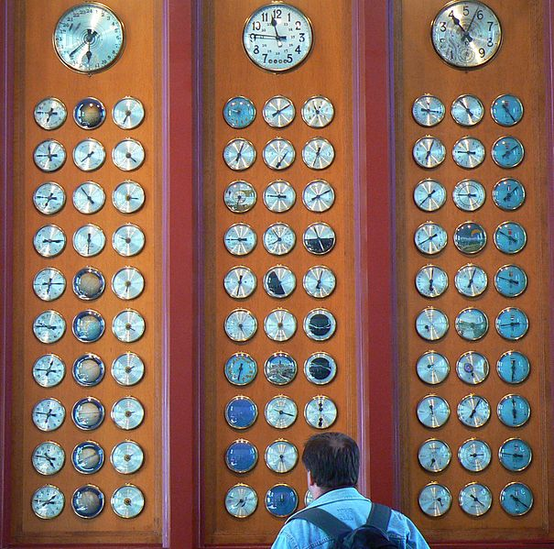
Totally ordered time:
recursive functions
2
Nothing depends on
its own future.
Quantities’ current values
can only depend
on their previous values
Notes:
2

Slide 3
Totally ordered time:
recursive functions
http://www.sxc.hu/photo/484676
3
Q_{curr}=F(Q_{prev} ,P_{prev})
Dependency works from ‘previous’ to ‘current’,
Q_{prev} and P_{prev} have no dependence on Q_{curr}.
So we won’t have Q_{curr}=F(Q_{curr} , …)
Evaluate F for each of the Q irrespective of the order.
Notes:
3

Slide 4
QUIZ
Totally ordered time:
recursive functions
It is not sufficient to have
Q_{curr}=F(Q_{prev}, P_{curr}).
Why not?
http://www.sxc.hu/photo/484676
4
Q_{curr}=F(Q_{prev} ,P_{prev})
Dependency works from ‘previous’ to ‘current’,
Q_{prev} and P_{prev} have no dependence on Q_{curr}.
So we won’t have Q_{curr}=F(Q_{curr} , …)
Evaluate F for each of the Q irrespective of the order.
Notes:
4

Slide 5
Totally ordered time:
recursive functions
http://www.sxc.hu/photo/484676
5
Q_{curr}=F(Q_{prev} ,P_{prev})
Dependency works from ‘previous’ to ‘current’,
Q_{prev} and P_{prev} have no dependence on Q_{curr}.
Notice that the following is problematic:
X_{curr}=F(X_{prev} ,Y_{curr})
Y_{curr}=G(Y_{prev} ,X_{curr}) ← X_{curr} = F(G(X_{curr}, ...))
Hence both arguments should be ‘prev’.
Notes:
5

Slide 6
Totally ordered time:
recursive functions
6
Q_{curr}=F(Q_{prev} ,P_{prev})
F is called a recursive function:
it calculates Q,
taking (an) earlier version(s) of Q
as argument.
http://commons.wikimedia.org/wiki/File:Recursive_Objects.jpg
Notes:
6

Slide 7
Totally ordered time:
recursive functions
http://www.sxc.hu/photo/480131
7
Example for arbitrary intervals:
A 120 km bicycle trip;
10 control posts, to be visited in right order
every post features a box full of bananas, B kCal each;
a list of ‘efforts’ (kCal) between subsequent posts, {E_{i}},
At which posts should you pick banana(s)?
Notes:
7

Slide 8
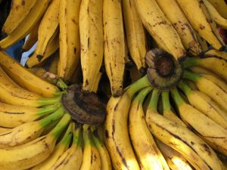
Totally ordered time:
recursive functions
8
Q_{i}=amount of kCal in stomach at post i, i > 0
Q₀=amount of kCal in stomach at start
Q_{i+1}=Q_{i}-E_{i} if you don’t eat
Q_{i+1}=Q_{i}-E_{i}+n_{i}B if you eat n_{i} bananas at post i
What is n_{i}?
max(0,…): you can’t eat a negative amount of bananas
⎡…⎤ : rounding up: you don’t want to eat a fraction of a banana
Notes:
8

Slide 9
Totally ordered time:
recursive functions
9
Q_{i+1}=Q_{i}-E_{i}+n_{i}B
n_{i} should be such that Q_{i+1}>0, as small as possible
Q_{i}-E_{i}+n_{i}B≥0,
so n_{i}B ≥ E_{i}-Q_{i}; n_{i}=max(0,⎡(E_{i}-Q_{i})/B⎤)
max(0,…): you can’t eat a negative amount of bananas
⎡…⎤ : rounding up: you don’t want to eat a fraction of a banana
Notes:
9

Slide 10
QUIZ
Totally ordered time:
recursive functions
⎡x⎤ means: the rounded-up value of x,
e.g., ⎡4.2⎤ = 5.
Why do we need to round up?
10
Q_{i+1}=Q_{i}-E_{i}+n_{i}B
n_{i} should be such that Q_{i+1}>0, as small as possible
Q_{i}-E_{i}+n_{i}B≥0,
so n_{i}B ≥ E_{i}-Q_{i}; n_{i}=max(0,⎡(E_{i}-Q_{i})/B⎤)
max(0,…): you can’t eat a negative amount of bananas
⎡…⎤ : rounding up: you don’t want to eat a fraction of a banana
Notes:
10

Slide 11
Totally ordered time:
recursive functions
11
Q_{i+1}=Q_{i}-E_{i}+n_{i}B
n_{i} should be such that Q_{i+1}>0, as small as possible
Q_{i}-E_{i}+n_{i}B≥0,
so n_{i}B ≥ E_{i}-Q_{i}; n_{i}=max(0,⎡(E_{i}-Q_{i})/B⎤), so
Q_{i+1}=Q_{i}-E_{i}+B*max(0,⎡(E_{i}-Q_{i})/B⎤)
or: Q_{i+1}=F(Q_{i},P_{i})
max(0,…): you can’t eat a negative amount of bananas
⎡…⎤ : rounding up: you don’t want to eat a fraction of a banana
← recursive function
Notes:
11

